Slide 1
CrushGrind “Baby” 100mm Shaft
Introducing the Mechanism of choice for all your smaller pieces of wood that are too beautiful too throw away!

Slide 2
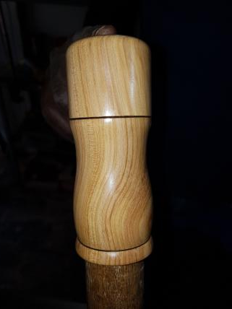
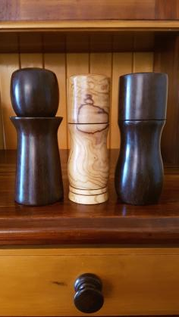
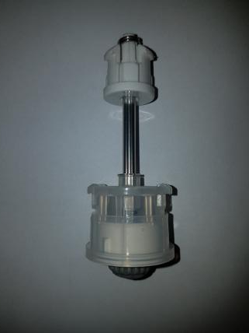
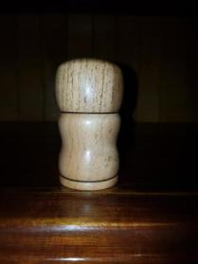
CrushGrind “Baby” 100mm Shaft
End Product
Selling at R160
Driver
90mm high
Grinder
120mm high
120mm high
One FREE for every 10 ordered

Slide 3
CrushGrind “Baby” 100mm Shaft
Tools Needed
25mm drill
19mm (3/4”) drill
MillDrill slide #4
Recess cutting tool slide #10
Helpful Shop made tools slide #27

Slide 4
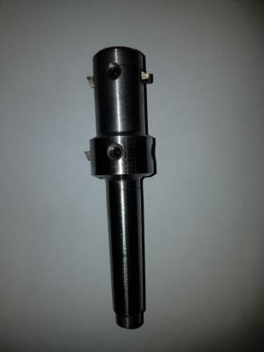
CrushGrind “Baby” 100mm Shaft
MillDrill Settings
Set the front cutter to cut a diameter of 33mm – cutting point must protrude 4mm
Grind down a bit
Set the back cutter to cut a diameter of 39mm – cutting point to protrude 4mm
Drill up to here
Practice these sensitive settings on sample wood to make sure that your mechanism fits perfectly!
Commercial!!
MillDrill For Sale at R690

Slide 5
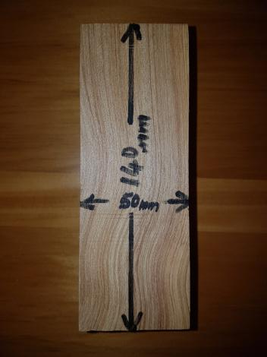
CrushGrind “Baby” 100mm Shaft
Recommended size of blank. (Smallest). Mount and turn to a cylinder.

Slide 6
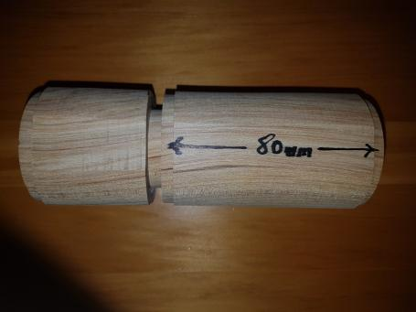
CrushGrind “Baby” 100mm Shaft
Cut 5mm spigots on both ends of the blank to fit your chuck
Measure and mark 80mm from the bottom spigot (excluding the tenon)
Mark 10mm more beyond the 80mm mark and cut two spigots of 5mm each side as follows:
Cut spigot on body side the same as spigot at bottom, and the other not smaller than 33mm in diameter

Slide 7
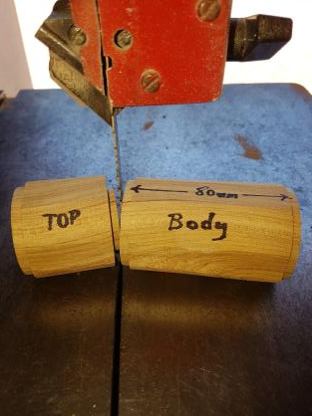
CrushGrind “Baby” 100mm Shaft
Part the Top from the Body

Slide 8
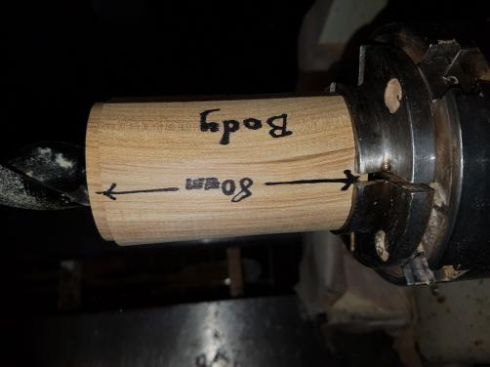
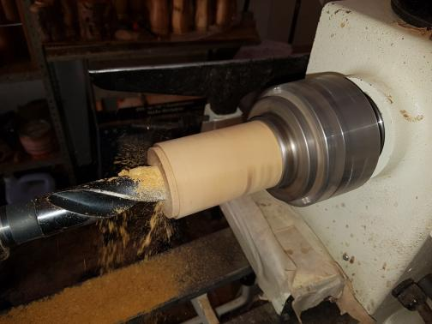
CrushGrind “Baby” 100mm Shaft
Chuck Body and drill right through with 25mm drill

Slide 9
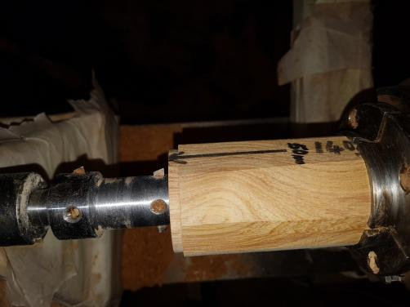
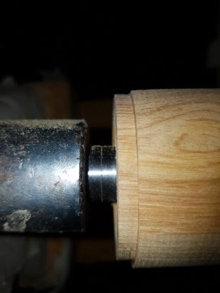
CrushGrind “Baby” 100mm Shaft
Follow the 25mm hole with the MillDrill up to here.

Slide 10
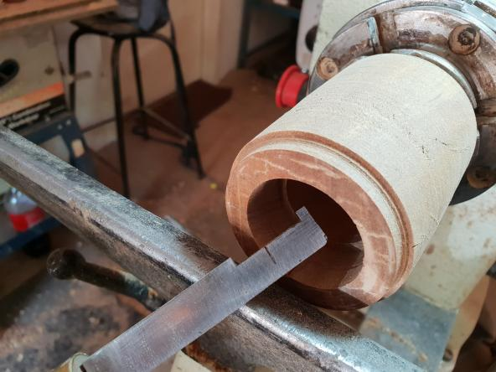
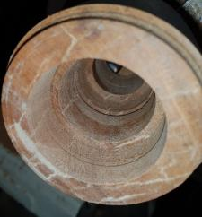
CrushGrind “Baby” 100mm Shaft
Use Shop made Recess Cutting Tool to cut recess inside for clips of mechanism
Recess
Commercial!!
Recess Cutting tool For Sale at R590

Slide 11
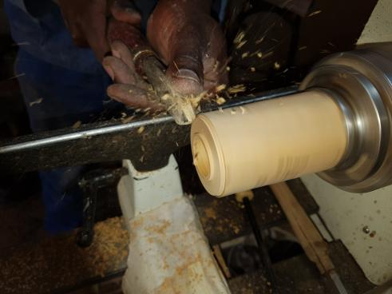
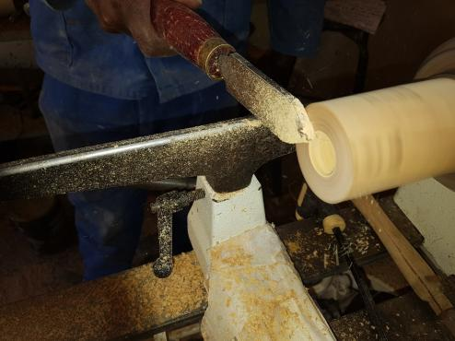
CrushGrind “Baby” 100mm Shaft
Reverse and chuck body on lathe; remove spigot from top part of the
body
Clean up to show the 25mm hole

Slide 12
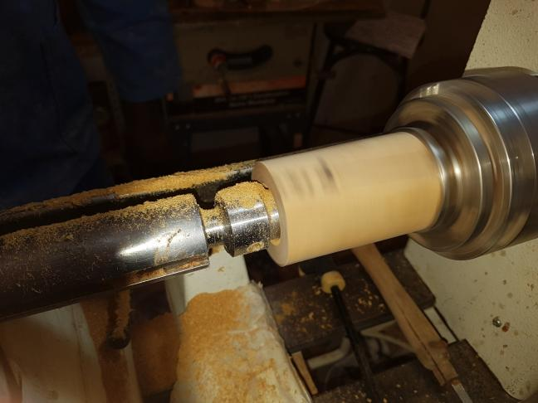
CrushGrind “Baby” 100mm Shaft
Use MillDrill to enlarge the 25mm hole (for spice reservoir). Drill to a position where front cutter meets bottom cavity previously cut

Slide 13
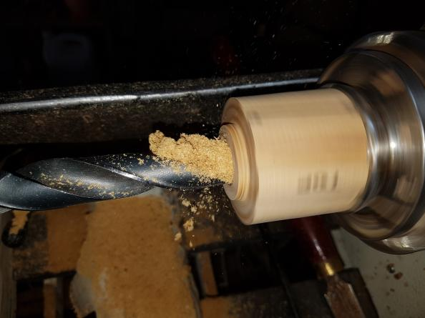
CrushGrind “Baby” 100mm Shaft
Drilling the Top
Drill 19mm (3/4”) hole >25mm deep into Top

Slide 14
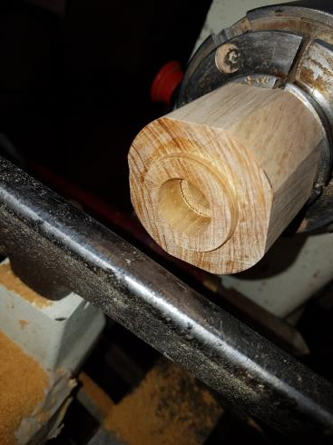
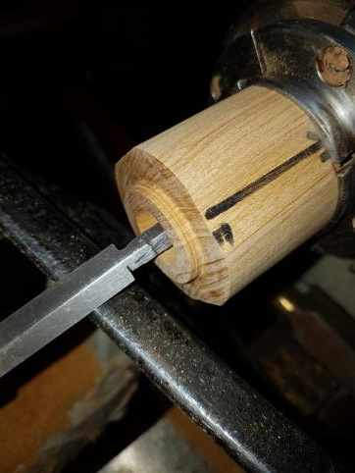
CrushGrind “Baby” 100mm Shaft
Use Recess Cutting Tool to cut the recess for the clips of the Driver to fit in.

Slide 15
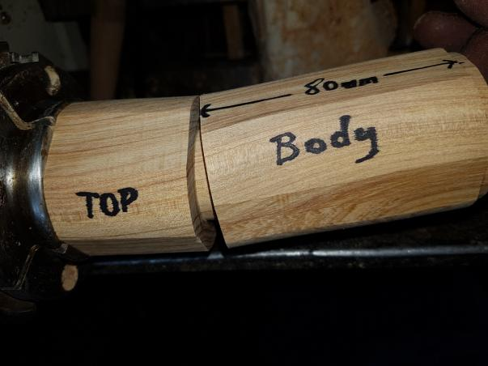
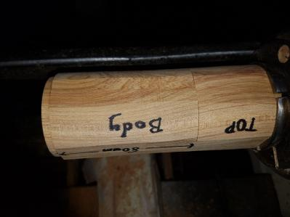
CrushGrind “Baby” 100mm Shaft
Turn spigot of top part smaller till it fits snugly
inside the top opening of the body

Slide 16
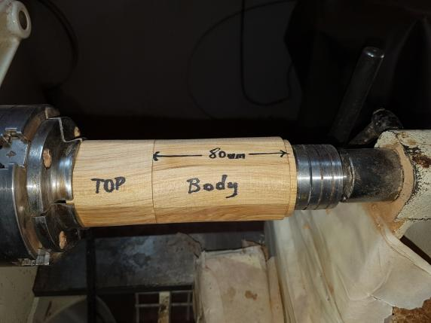
CrushGrind “Baby” 100mm Shaft
Line up top and bottom to start designing
Remove bottom spigot – use a revolving centre in tailstock that fits inside body

Slide 17
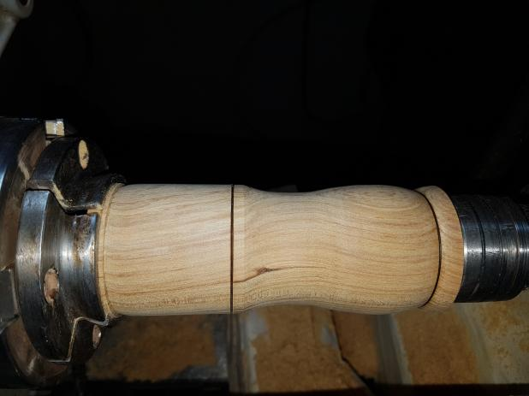
CrushGrind “Baby” 100mm Shaft
Design to your heart’s delight!

Slide 18
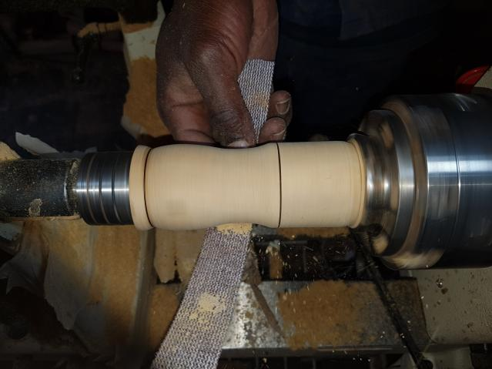
CrushGrind “Baby” 100mm Shaft
Sand through all the grits from 80 to 400

Slide 19
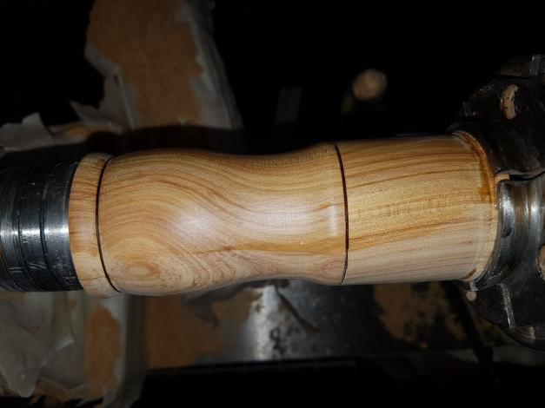
CrushGrind “Baby” 100mm Shaft
Apply 3 layers of 50/50% mix of Sanding Sealer and Thinners. Wipe on only when stationary.

Slide 20
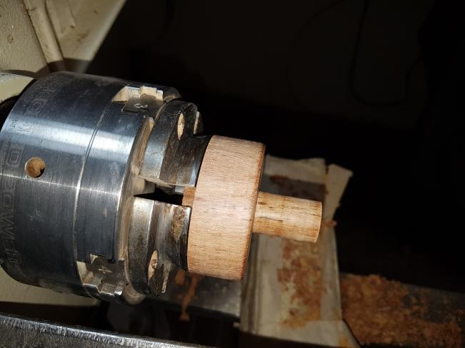
CrushGrind “Baby” 100mm Shaft
Make a “Jam Chuck” to fit the 19mm (3/4”) hole of the Top

Slide 21
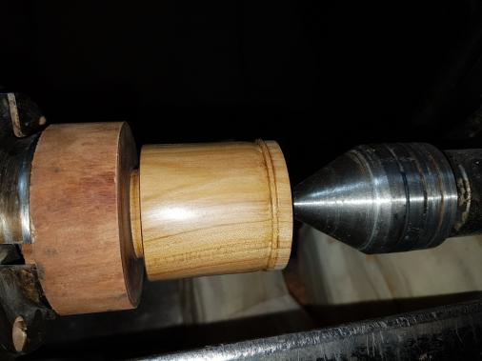
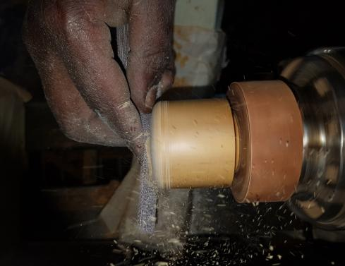
CrushGrind “Baby” 100mm Shaft
Mount Top on “Jam Chuck”, support with live centre and finish shape
Sand and finish with Sanding Sealer mix

Slide 22
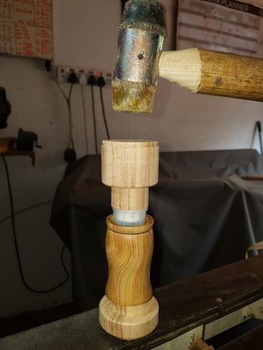
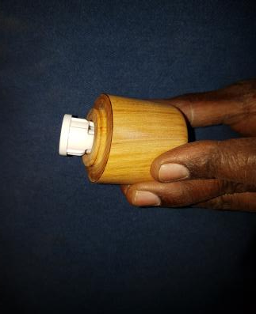
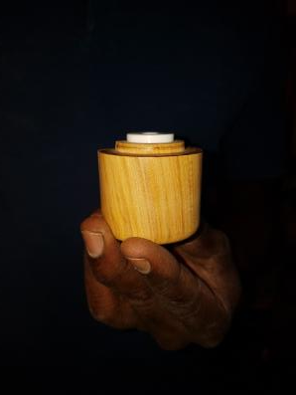
CrushGrind “Baby” 100mm Shaft
Tap mechanism into position with a shop made “Tap Tool” and “Stem Guide”
Tap Driver in position with a mallet
See Slide #27
for tools

Slide 23
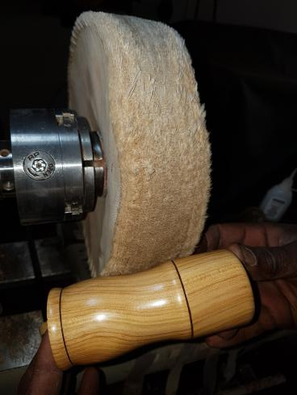
CrushGrind “Baby” 100mm Shaft
Buff wood with mixture of Carnauba and Bees Wax
Commercial!!
Blocks of Wax mix For Sale at R100

Slide 24
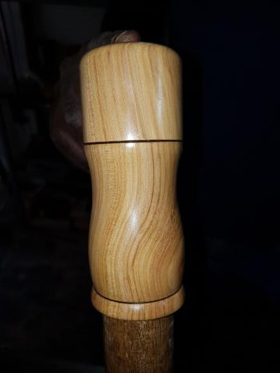
CrushGrind “Baby” 100mm Shaft
Finished product.
Ready for the Market!

Slide 25
CrushGrind “Baby” 100mm Shaft
Thank You!!
Piet and Charlie.

Slide 26
Way Forward
“Pepper Mills 101” – a 2 hours course @ R490
We offer a Saturday morning course on the above process, as the need arises.
The course includes a ‘take home’ CrushGrind mechanism worth R180
We offer a bulk discount on any future orders. On every 10 mechanisms you order, you receive one free of charge

Slide 27
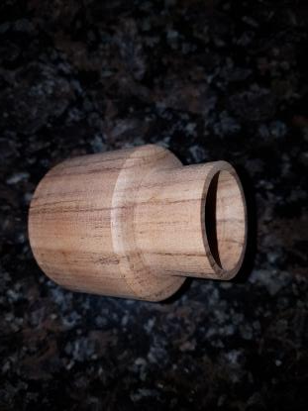
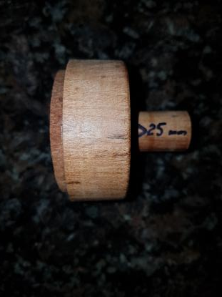
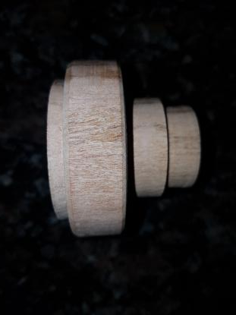
CrushGrind “Baby” 100mm Shaft
Handy and helpful shop made jigs
“Stem Guide” as in slide #22. Drill a small hole right trough to guide the stem to help you with a square seating.
“Tap Tool” to tap mechanism in place with a mallet
“Jam Chuck” to finish top, as in slide #20
Diameter < 39mm
To fit loosely into Body
Don’t make this tool to short otherwise your stem will hit the table before the mechanism seats. (Been there, done it!)
Rim must just touch plastic sides of mechanism

Slide 28
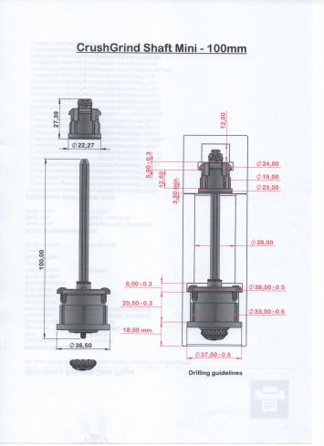
CrushGrind “Baby” 100mm Shaft

Slide 29
CrushGrind “Baby” 100mm Shaft

Slide 30
CrushGrind “Baby” 100mm Shaft

