Slide 6
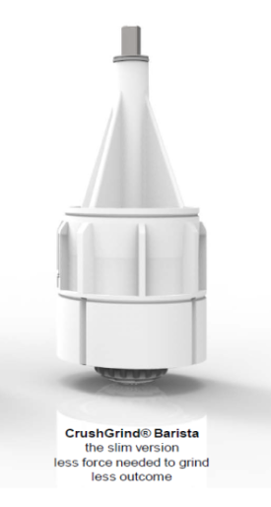
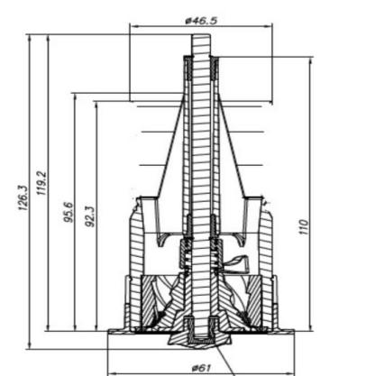
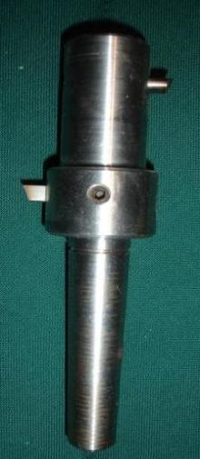
GOOD NEWS FOR MILLDRILL OWNERS – R690 EACH

Slide 7
Pepper Mills For Africa (Pty) Ltd
Introducing the
The Barista CrushGrind
Coffee Grinding Mechanism
Milling Gourmet Coffee
for the
Connoisseur

Slide 8
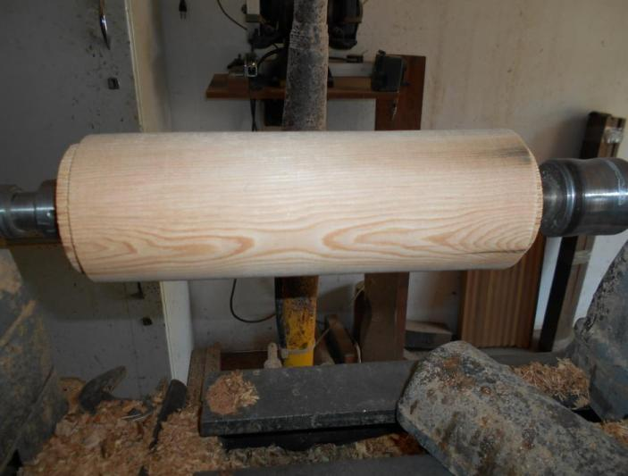
Safety First – Always work between centre’s and observe all safety rules
If your lathe starts to shudder dive for cover –
switch off later (Slaan dekking!)

Slide 9
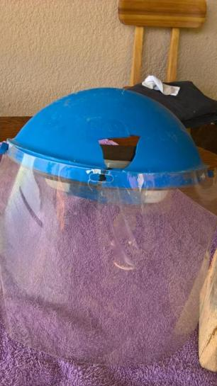
With approval of Frans Gericke

Slide 10
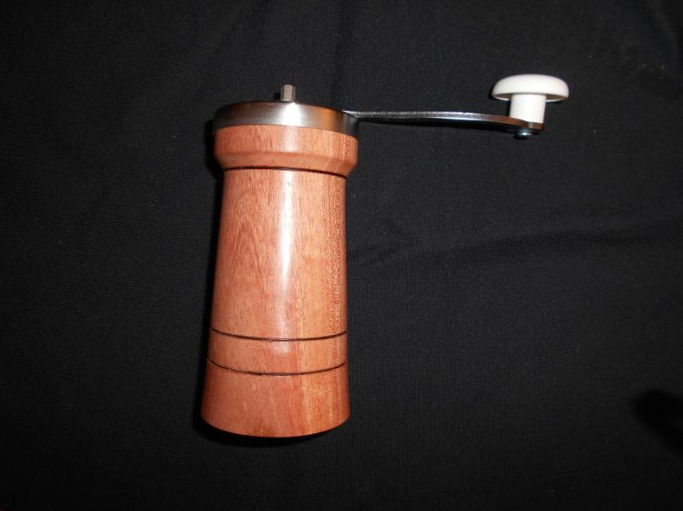
Target

Slide 11
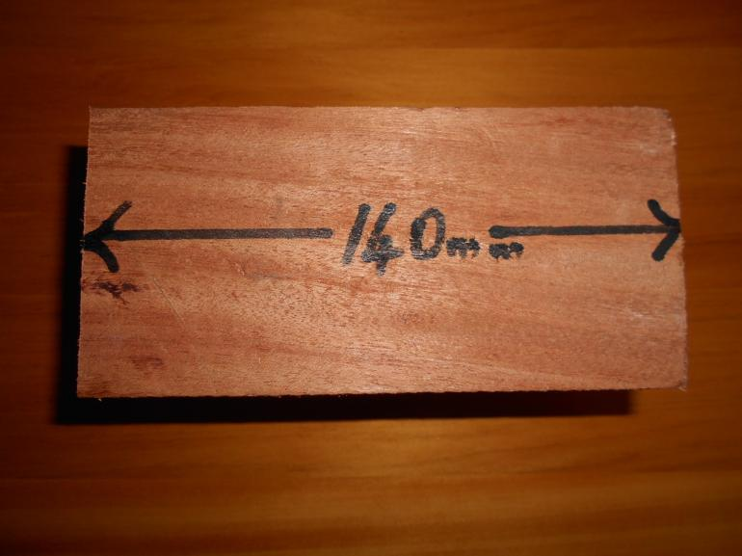
140mm x 80mm x80mm

Slide 12
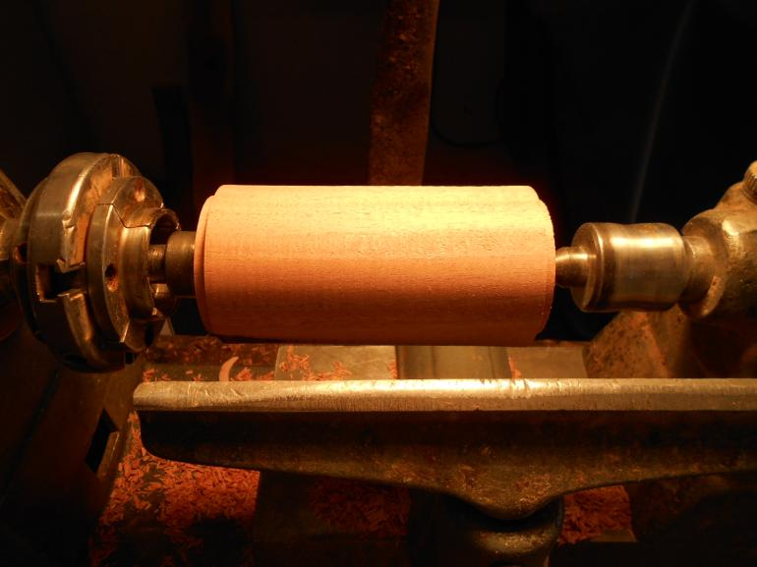
Turn tenons on both sides of blank to fit your chuck

Slide 13
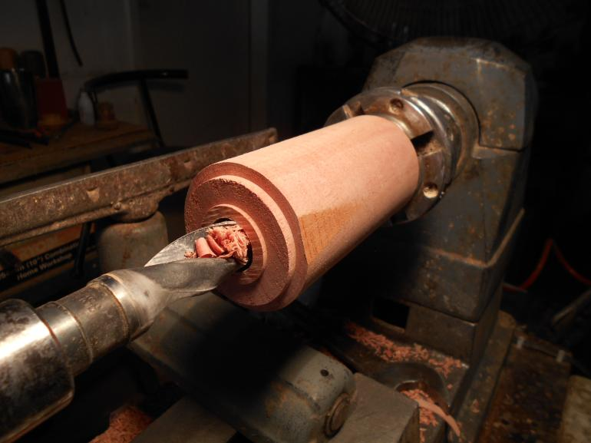
Drill 25mm hole right through the blank (Turn around if needed)

Slide 14
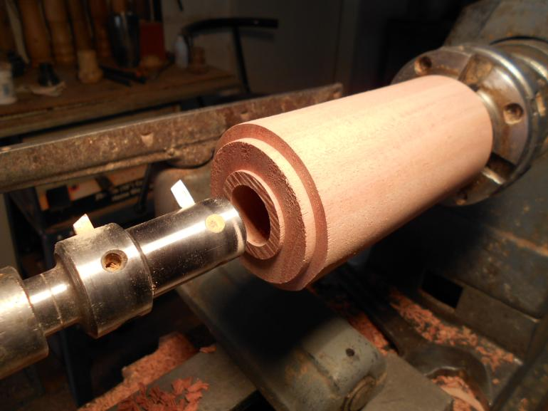
Use your MillDrill (extended to 46mm) to drill to maximum depth
If you don’t have one widen the whole to 46mm with skew

Slide 15
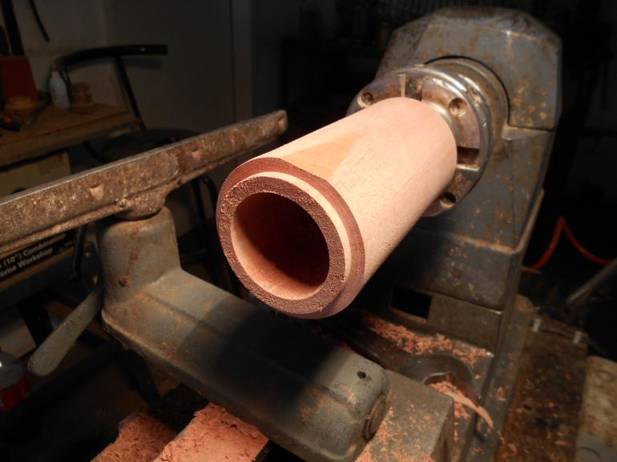
Done! Test with mechanism to fit loosely

Slide 16
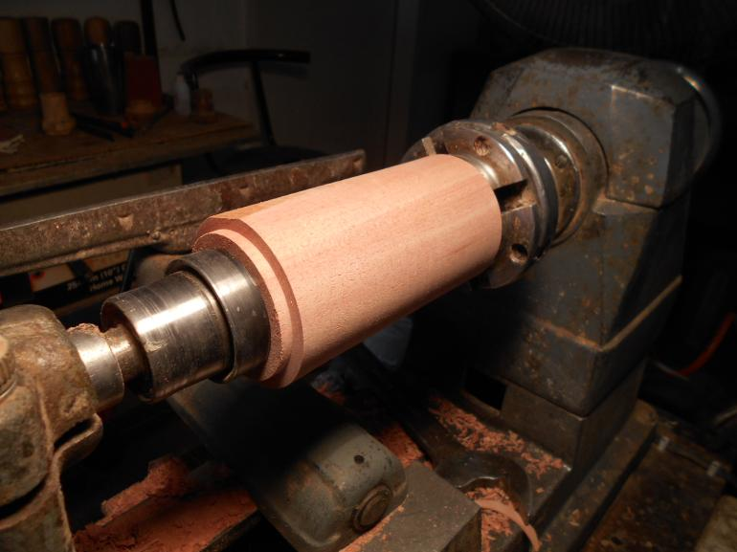
Steady tailstock in preparation for design

Slide 17
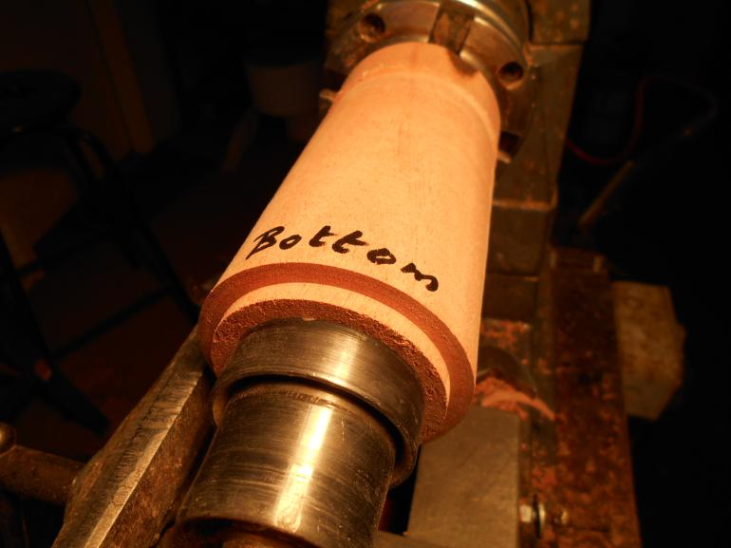

Slide 18
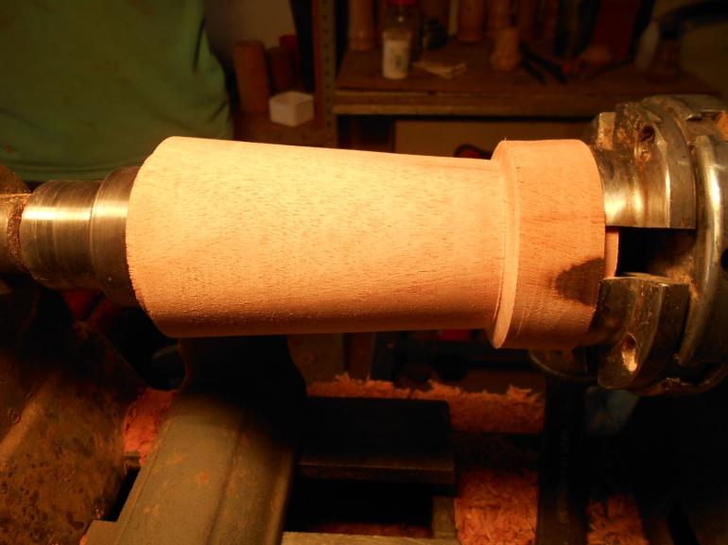
Design of your choice “Coffee Pot” style

Slide 19
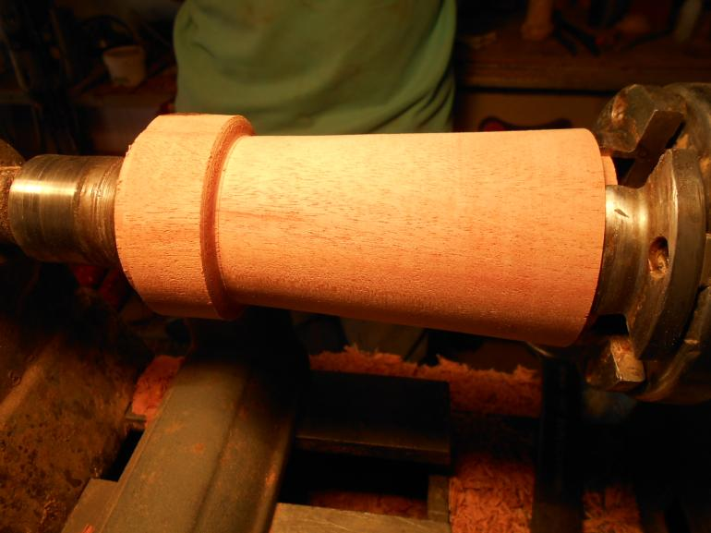
Turn around to remove tenon not needed anymore

Slide 20
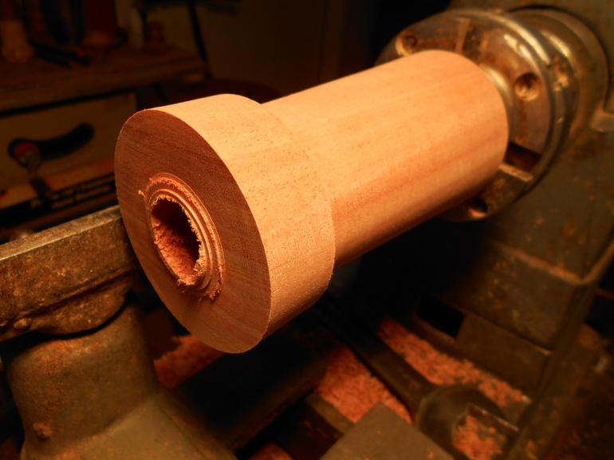
Remove tenon safely

Slide 21
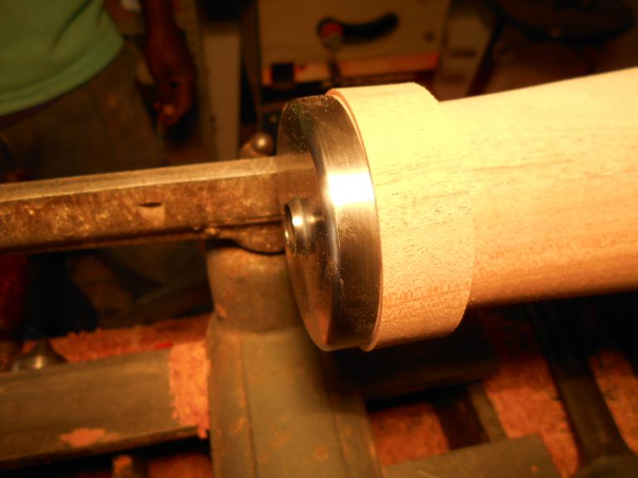
Start fitting top >65mm

Slide 22
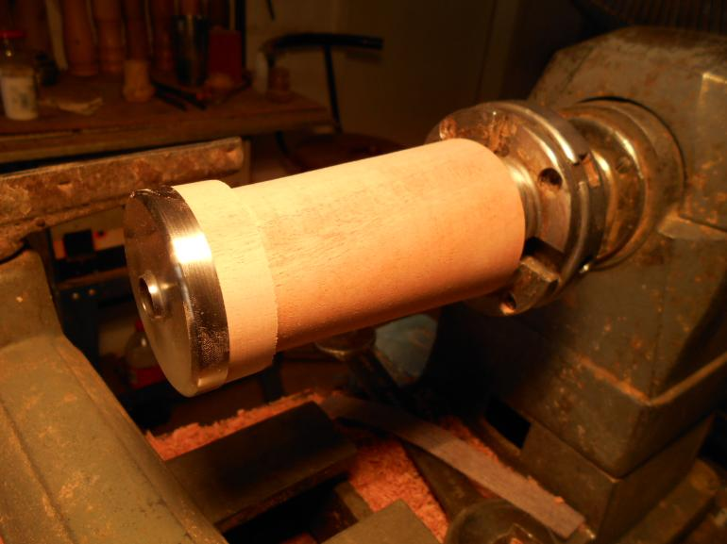
Fitted snugly for a lady to remove

Slide 23
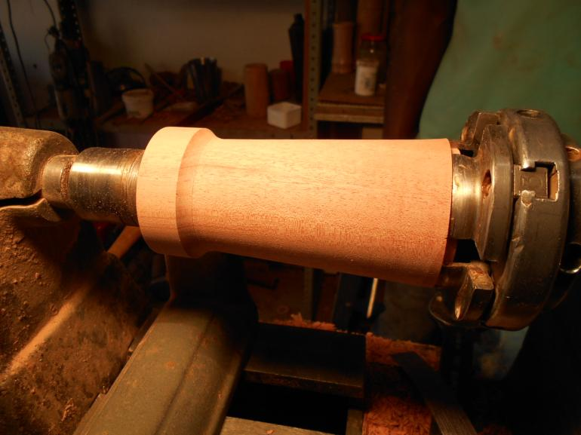
Finish “Coffee Pot” design

Slide 24
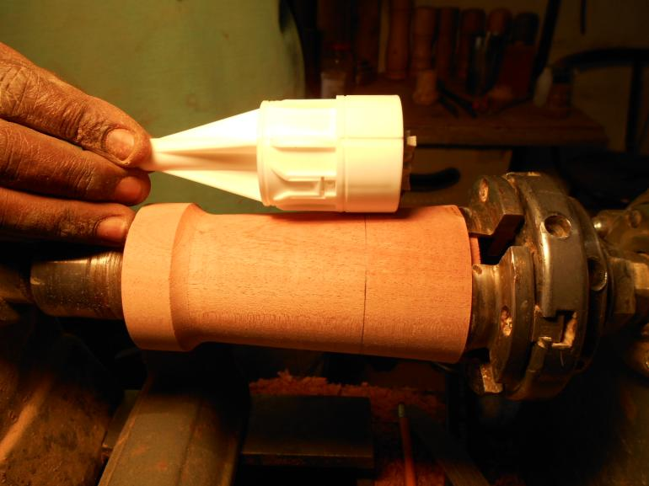
Lay out mechanism. Top to just protrude.
Mark middle of bottom section of mechanism where ceramic frame is

Slide 25
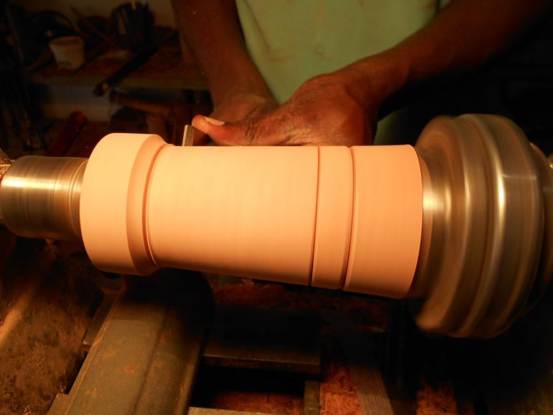
Design grooves to be burnt
Marked groove

Slide 26
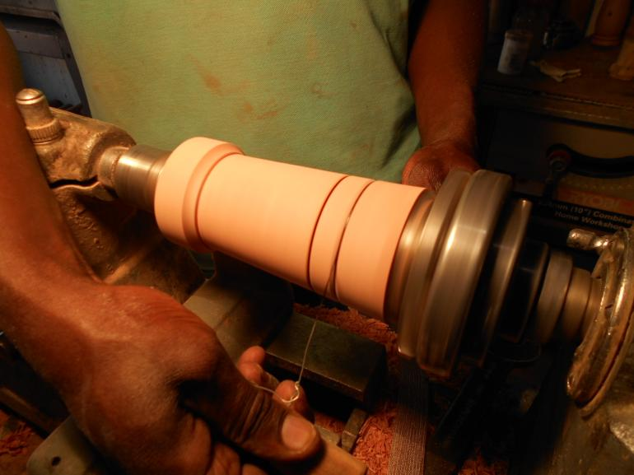
Burn grooves with wire

Slide 27
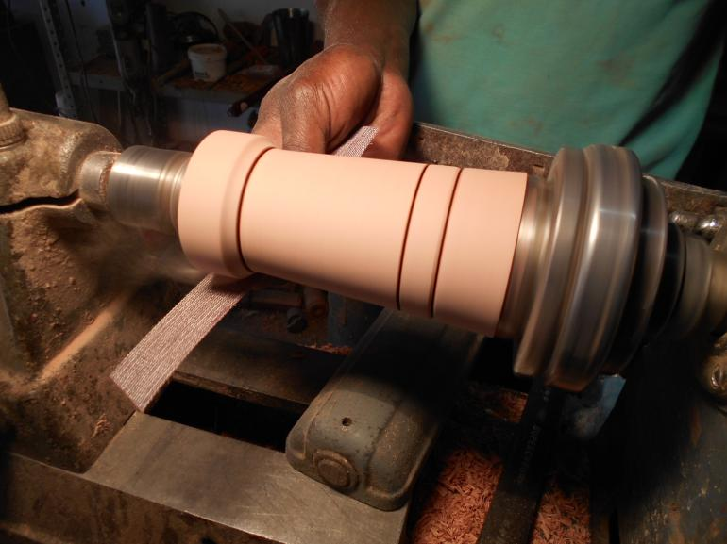
Sand (Abranet) 100 to 400 grid
Be careful not to over sand the
Area where the cap fits!!

Slide 28
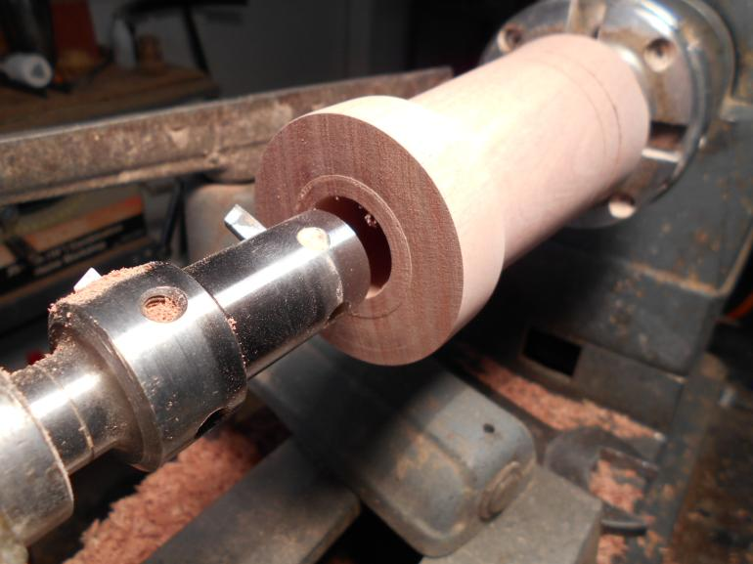
Use MillDrill to drill 46mm
right trough coffee grinder
If you don’t have a MillDrill use a skew

Slide 29
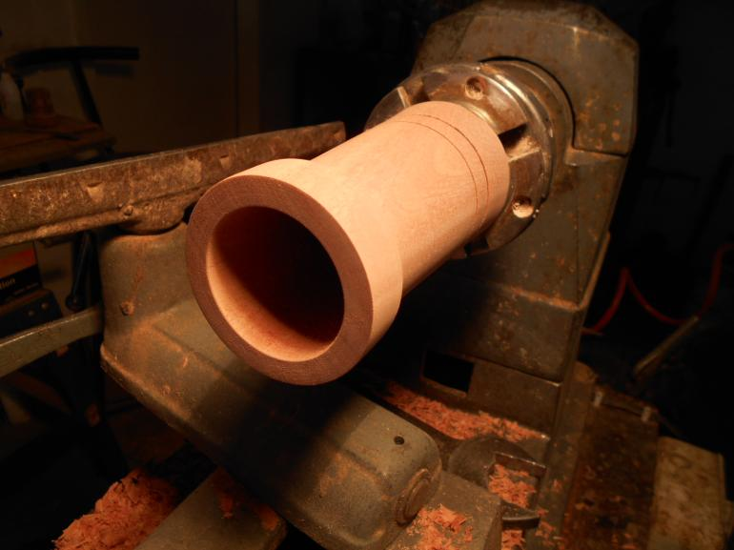
Done – Sanded inside

Slide 30
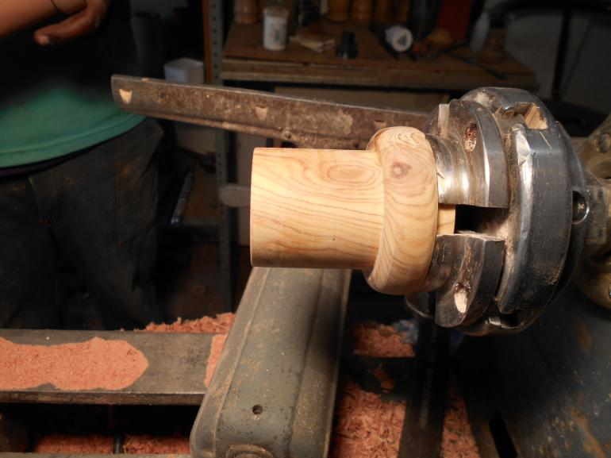
Shop made “Jam Chuck” 46mm tight fit

Slide 31
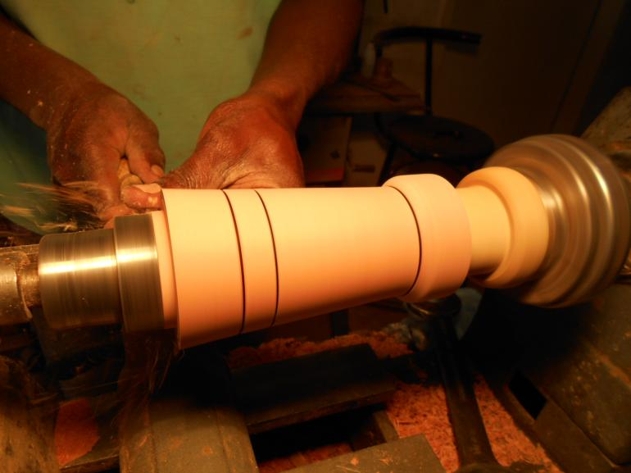
Stabilize with revolving tailstock and remove tenon

Slide 32
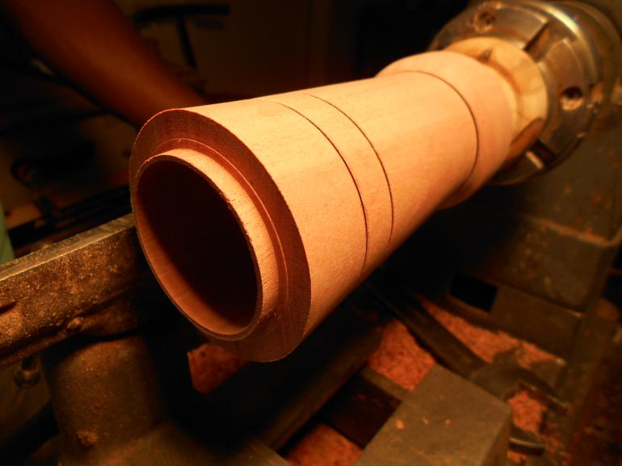
Remove tenon carefully

Slide 33
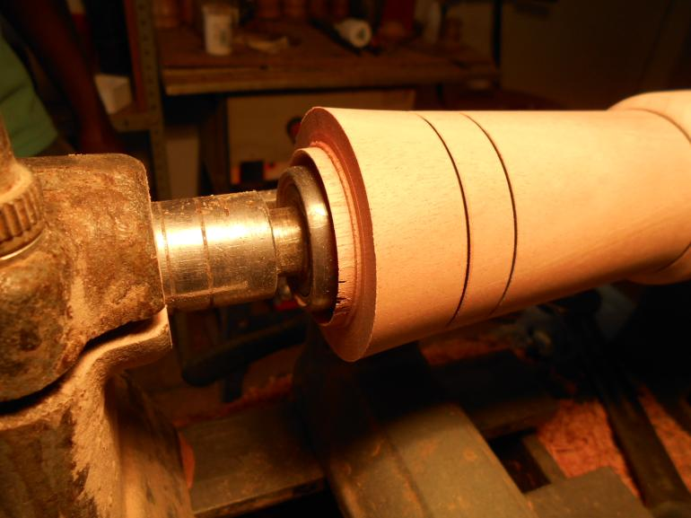
Stabilize with “dummy” revolving tailstock inside

Slide 34
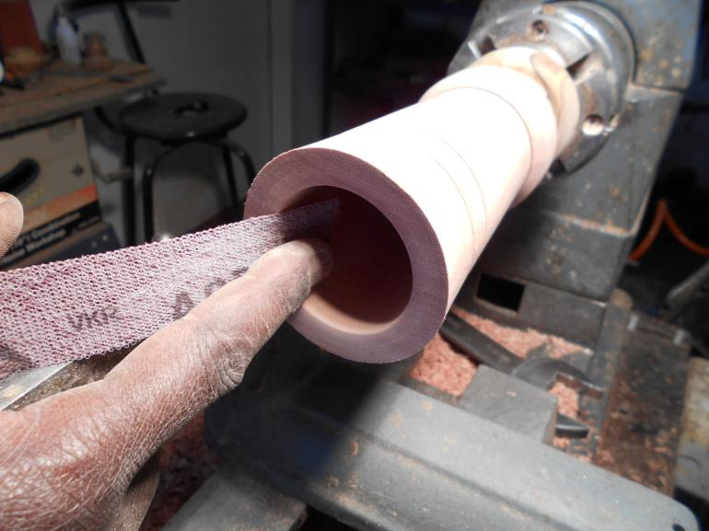
Sand sharp edge for lady’s fingers

Slide 35
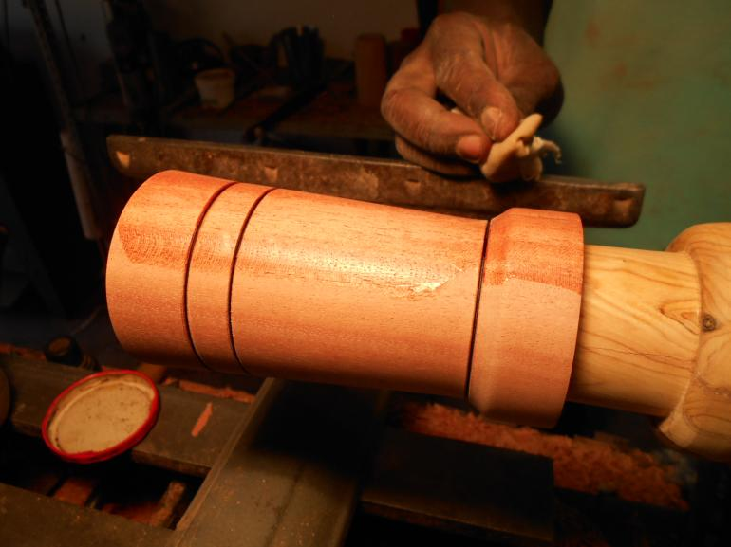
Apply three layers of 50% sanding sealer
and 50% thinners mix – do not spin on!

Slide 36
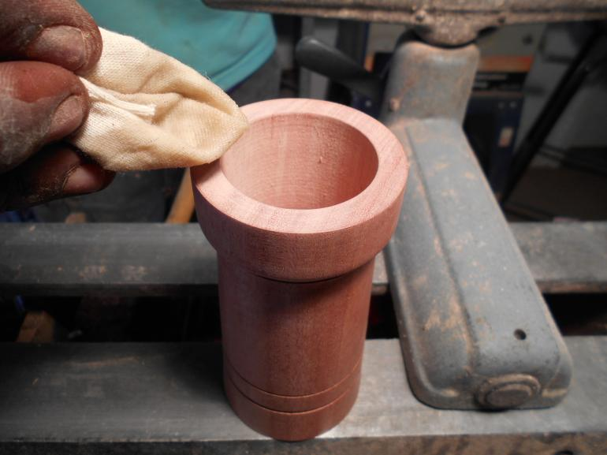
Apply same mix inside

Slide 37
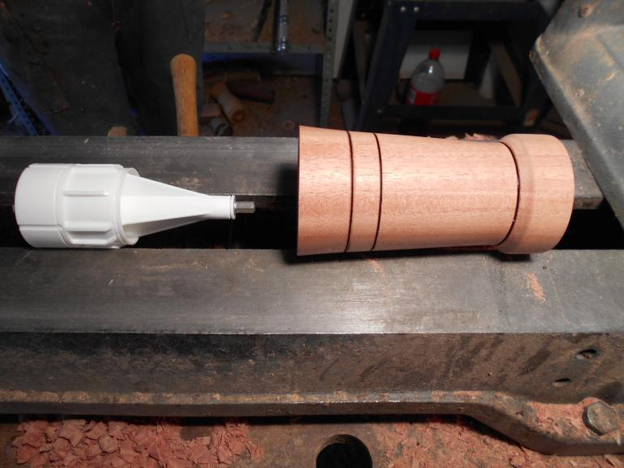
Fitting the mechanism

Slide 38
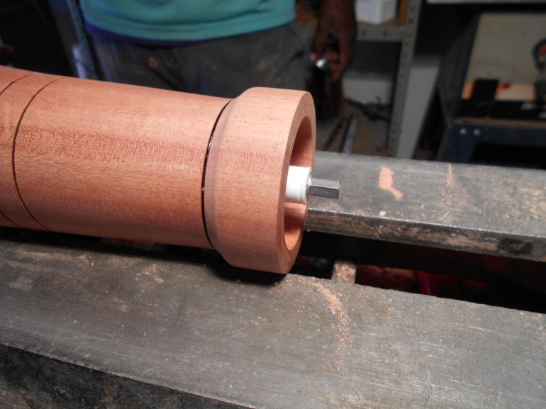
Push mechanism in till it protrudes slightly to fit top as per next slide

Slide 39
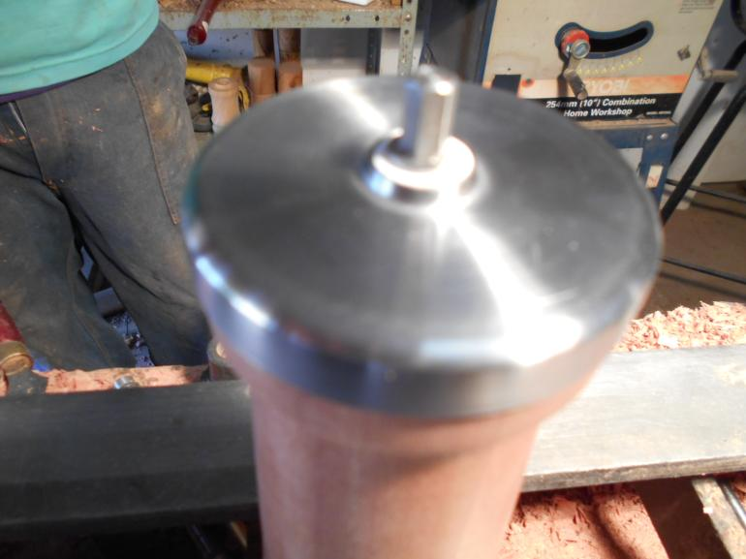
Lid fitting precisely over protruding mechanism stem

Slide 40
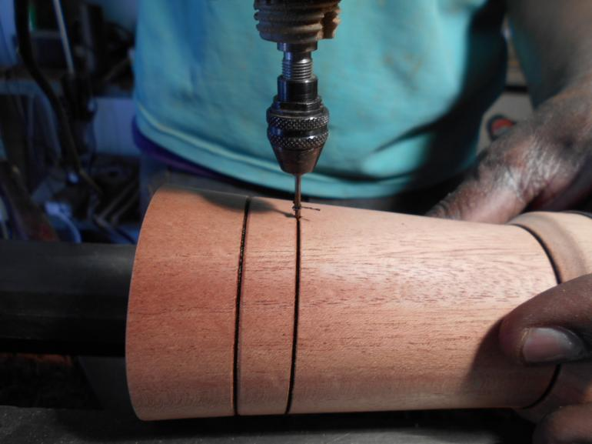
Drill small hole till drill touches ceramic on line previously marked

Slide 41
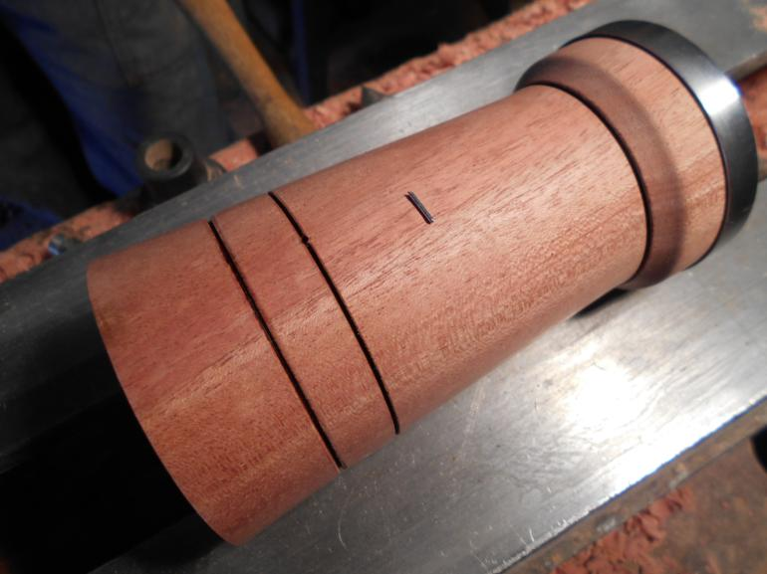
Press pin into hole to lock mechanism from moving
(Both sides if you wish)

Slide 42
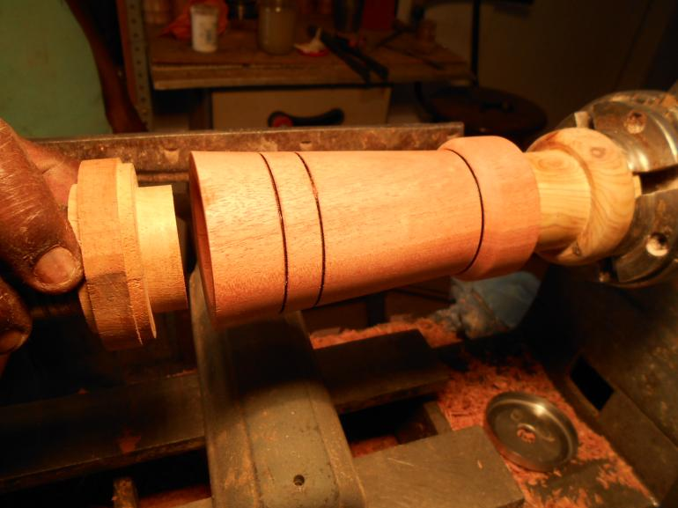
“Jam chuck” both sides to reburn grooves – to hide pin hole(s)

Slide 43
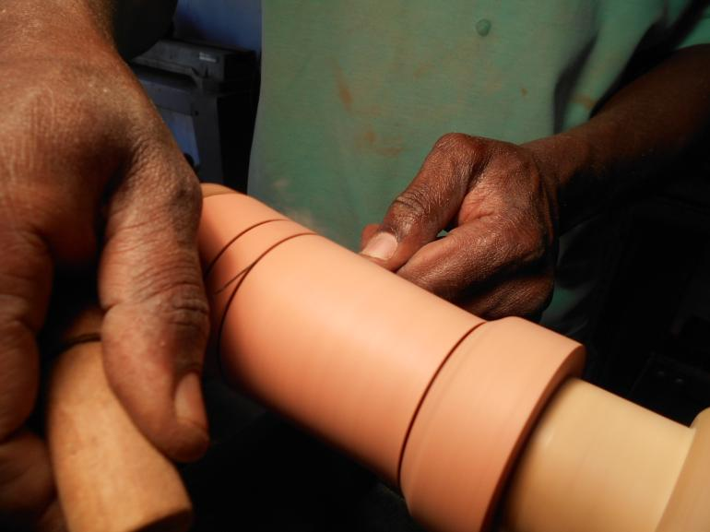
Re-burn grooves

Slide 44
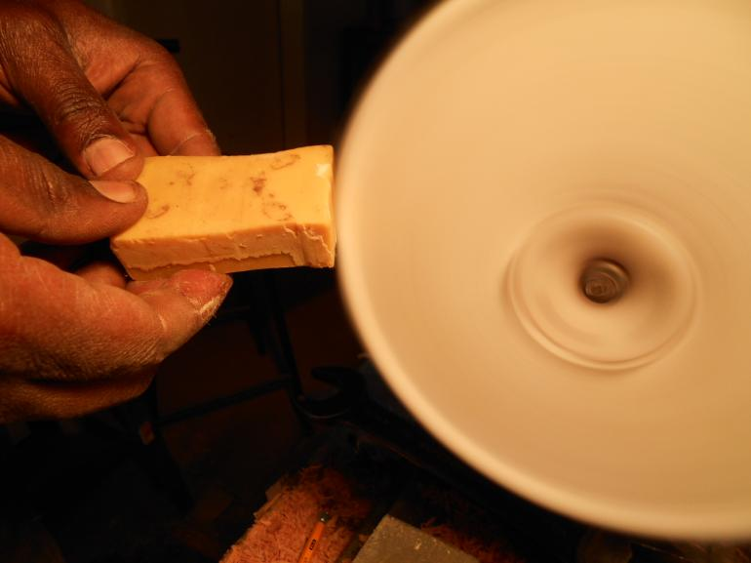
Lightly touch Carnauba and Bee wax mix on polishing buff

Slide 45
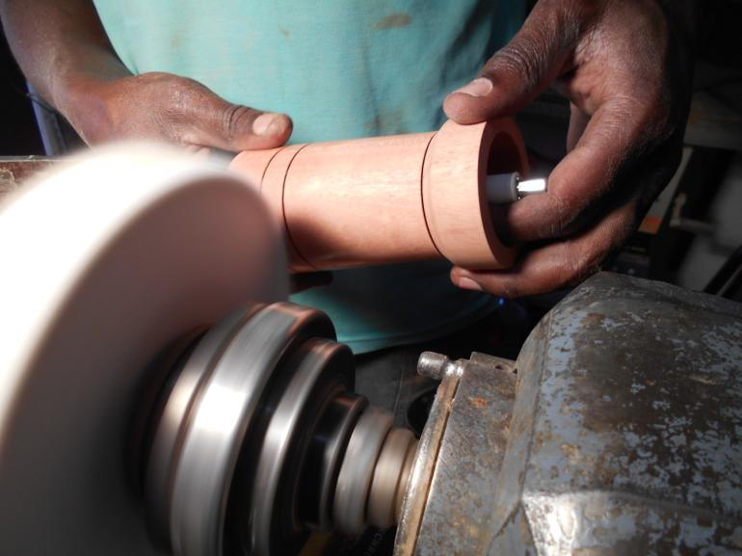
Buff

Slide 46
Voila! Ready for the market – Sell at about R890 t0 R990
Cost of mechanism, handle and lid = R490
One free for every 10 bought

Slide 47
THANK YOU!!
Piet and Charlie

